Slide 1


Vacation Rental Property Finder In South FL
By: Jim Lao, Mark Olson, And Krishna Pandari

Slide 2
Project Overview
The Vacation rental property finder/comparison tool aims to assist users in finding and comparing rental properties for their stays. Whether planning a getaway or relocating, users can explore available properties, filter based on preferences, and visualize essential information.
With an emphasis on the data visualization track.

Slide 3
Data Gathering
Airbnb/VRBO
Web scrape the data from their web pages
Create Database
Store data into a data table to be used to create visualizations
Create Tables/Views
Using the source data create supporting data tables needed for views

Slide 4
Discuss Web Scraping
Web Scraping

Slide 5
Data tables / Storage
Once the data has been scraped from the Airbnb and VRBO Web Pages we begin the data cleaning process
We viewed the data and only kept any relevant data for analysis and data visualizations as needed.
Once we had the data cleaned and workable we merged the two datasets together and moved them into one table so the data isn’t stored in multiple tables. So when we create new data tables or views everything is stored in one source table.

Slide 6
Flask API server / Web frontend
Backend
Frontend
Three FLASK API endpoints
1. index/
Parameters: none
Result: Loads the Frontend ( renders index.html )
2. get_properties()
Parameters: destination, min_price, max_price, bedrooms, bathrooms
Returns: json list of dictionaries containing property details
3. get_destinations()
Parameters: none
Returns: json list of city location names
SQLAlchemy Interface to PostgreSQL
Data Mapping
SQL calls
HTML
Main structure of the web page
Selection controls
Fetch button … triggers Javascript
Leaflet / SweetAlert2
Map Background (tiles) Layer
Markers with Popups
JavaScript
1. Initial page load
Loads Leaflet map background
API call to get_properties() & map markers
API call to get_destination() & drop-down
2. Selection controls were modified
API call to get_properties() & map markers

Slide 7
Show HTML DEMO

Slide 8
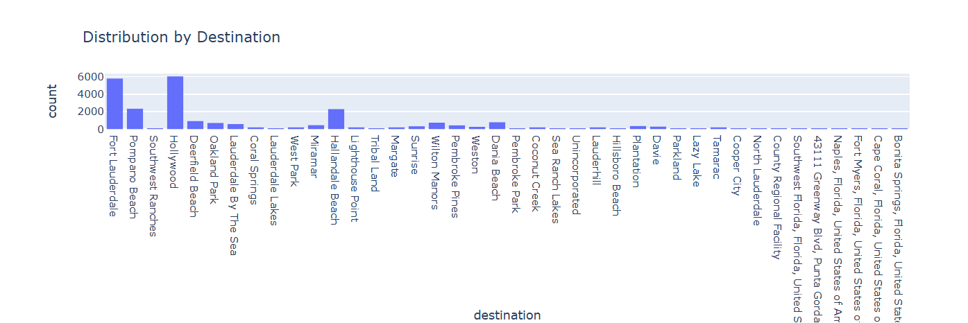
Location
When looking at the location pulled from the scraping we see that most of the rental locations are either in Fort Lauderdale, Hollywood, and Hallandale Beach.
From what we can see from the data is that these locations are where vacation goers are most likely to venture out to.

Slide 9
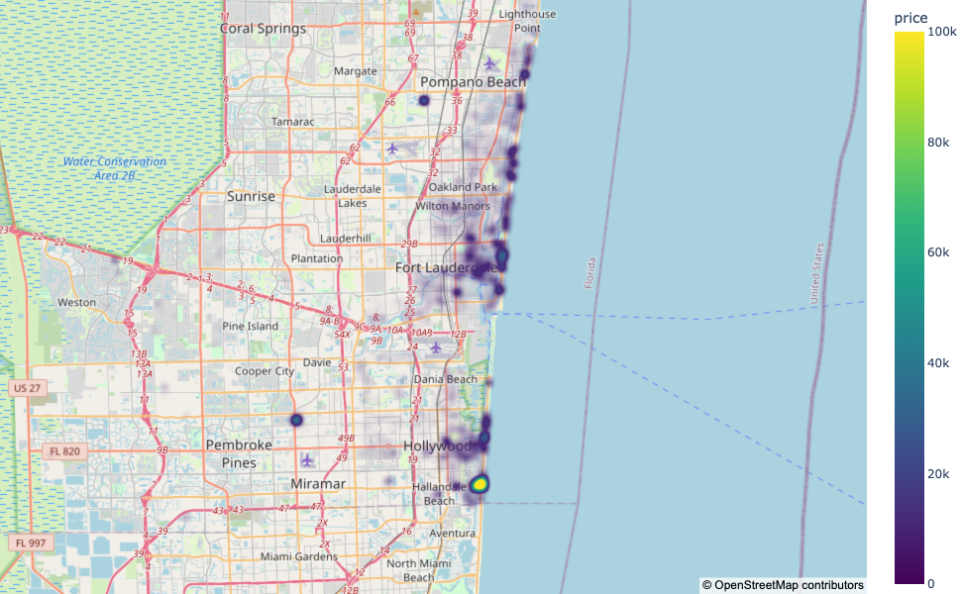
HeatMap of Rental Properties in SE FL

Slide 10
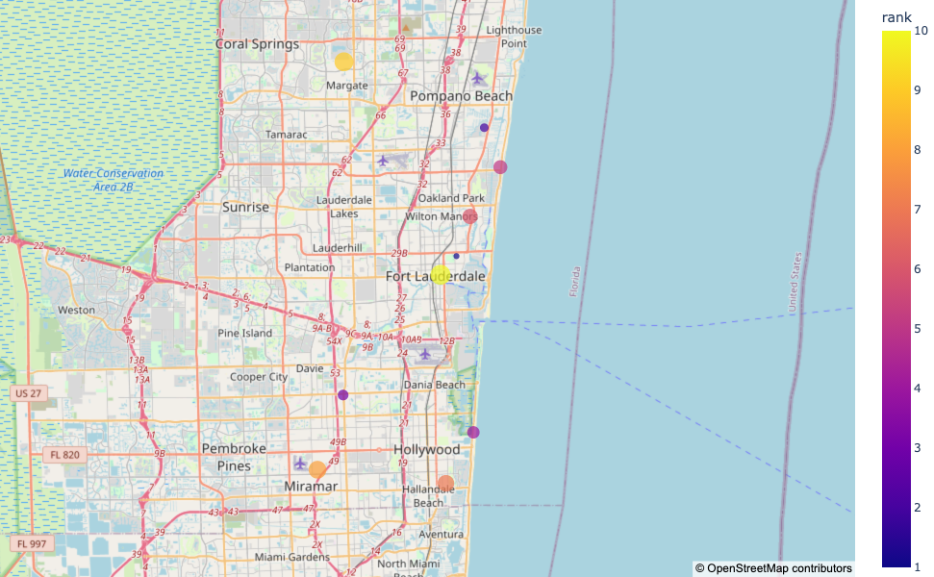
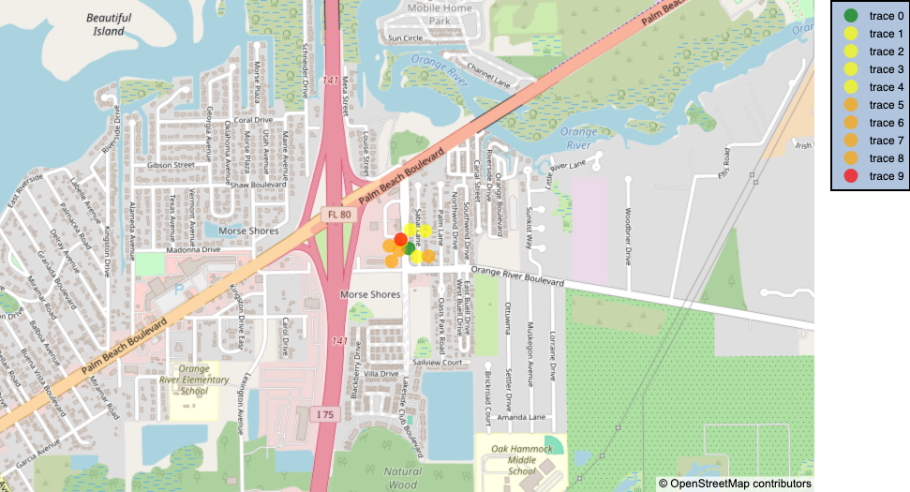
Top 10 Rental Locations

